Slide 1








WEB BASEDPROFILE ANALYZER
By Team STELLARS

Slide 2






Team STELLARS
STEPS TO
HIRE!!!

Slide 3

Team STELLARS
INTRODUCTION
Required Skill?
Behaviour?
Technical?
Social communication?
Nature?
HIRE?

Slide 4

Team STELLARS
EXISTING APPLICATIONS
Manual task overhead
Biased Score
no skill verification
No behaviour analysis
No Social Media Analysis

Slide 5

Team STELLARS
OUR SOLUTION/IDEA
Comprehensive Skill Verification
Behavioral Analysis
Data-Driven Merit Evaluation
Weighted unbiased Decision-Making
User-Centric Design
Psychometric Analysis

Slide 6

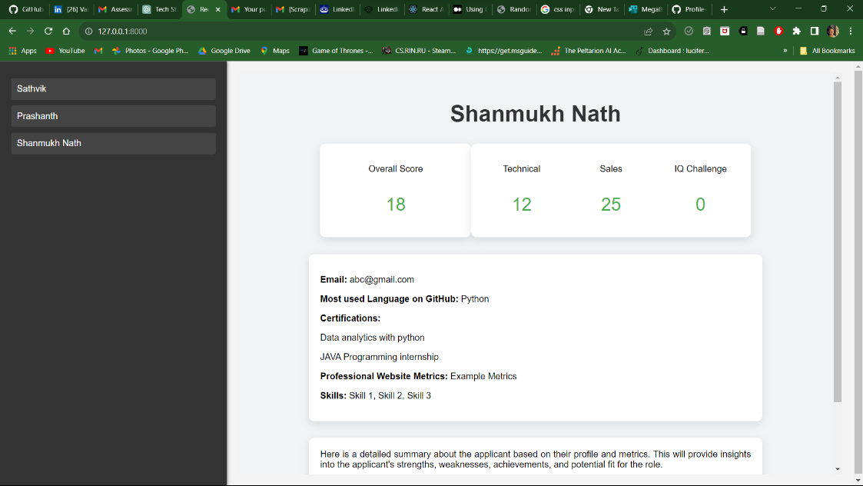


Team STELLARS
OUR RESULT

Slide 7

Team STELLARS
CONCLUSION
our application serves as a link between employers and workers to get overview of capabilities of candidates.
Recruiters - Get a visual framework to evaluate an applicant's behaviour and talents

Slide 8

Team STELLARS
Q/A SESSION
QUERIES?

Slide 9
THANK YOU
Team STELLARS

